Slide 1
AMC 10 美国数学竞赛
AMC t0 Advanced Class Teacher : Mr. Zheng

Slide 2
0
1
Lesson 1
Topics in Algebra

Slide 3
Chapter 1
Absolute Value

Slide 4
Lead in

Slide 5
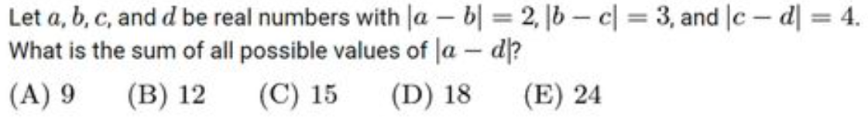
Example

Slide 6
Chapter 2
Integral Function

Slide 7
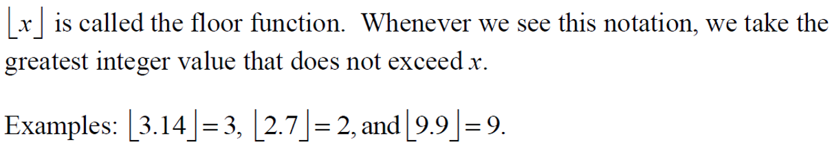
Lead in

Slide 8
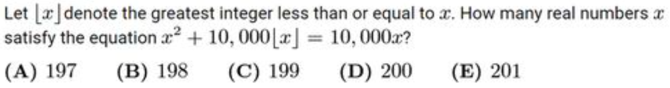
Example

Slide 9
Chapter 3
Base-n a.k.a. n-adic

Slide 10
Lead in

Slide 11
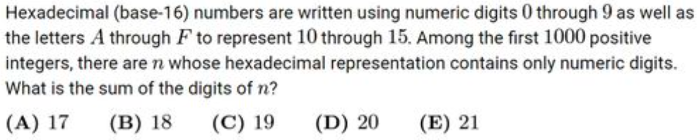
Example

Slide 12
Chapter 4
Completing Square

Slide 13
Lead in

Slide 14
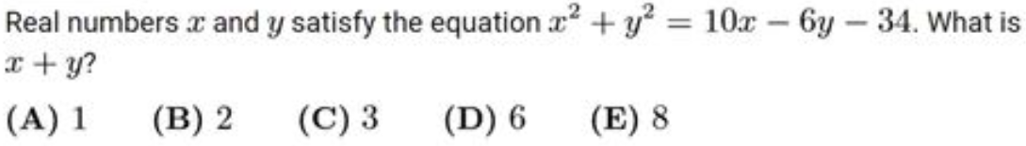
Example

Slide 15
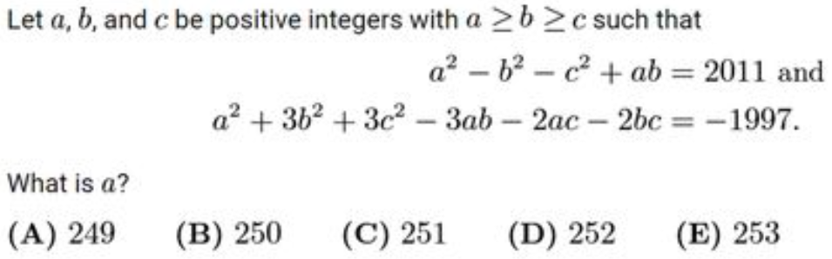
Example

Slide 16
Chapter 5
Discriminant

Slide 17
Lead in

Slide 18
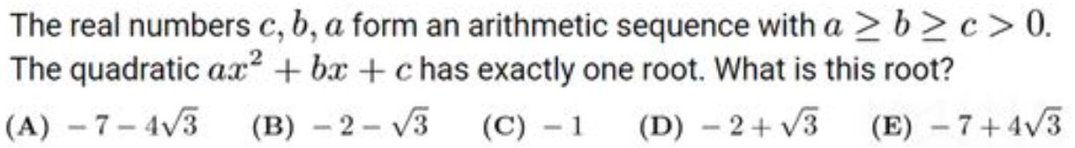
Example

Slide 19
Chapter 6
Vieta's Formula

Slide 20
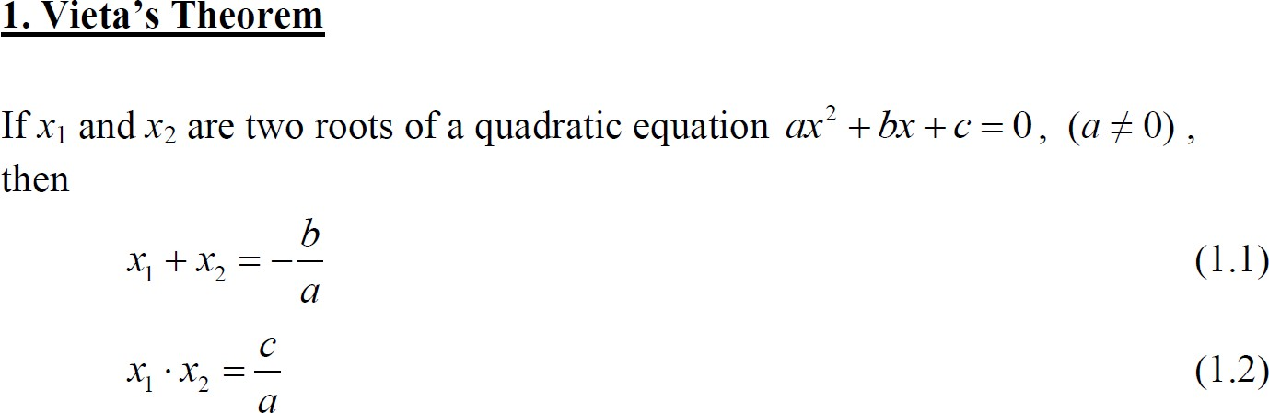
Lead in

Slide 21
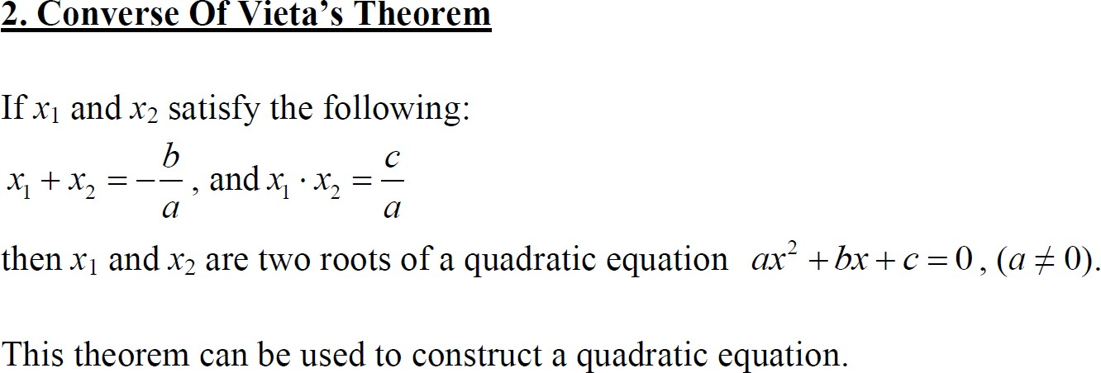
Lead in

Slide 22
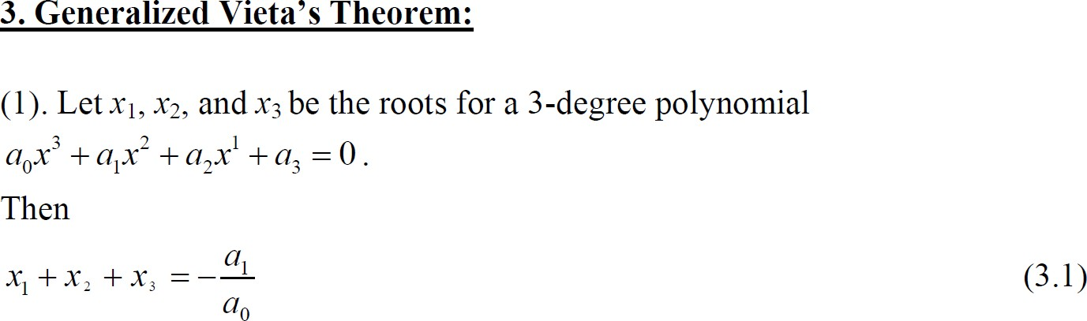
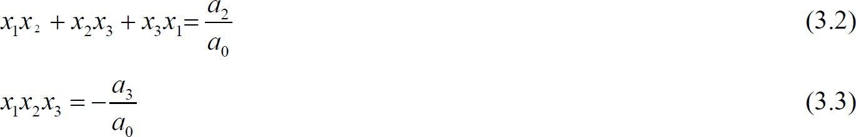
Lead in

Slide 23
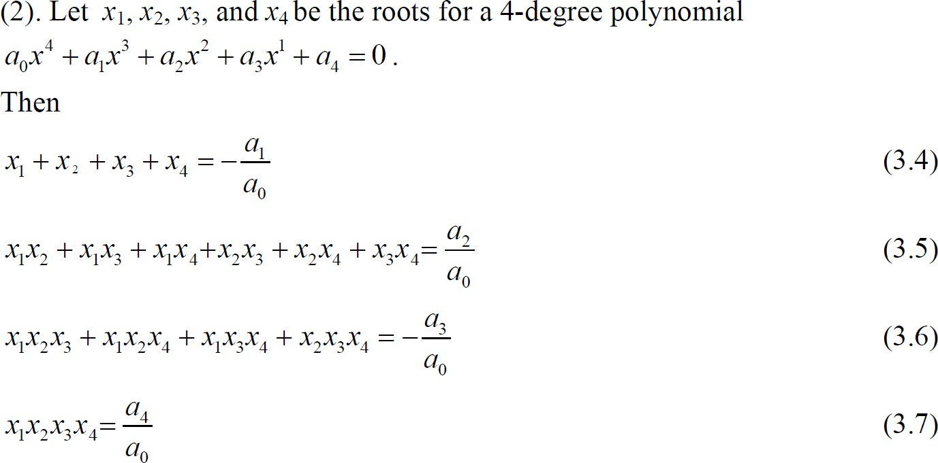
Lead in

Slide 24
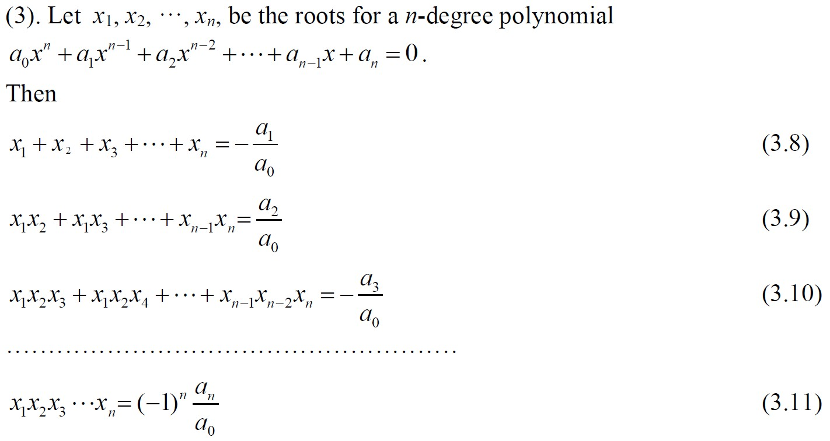
Lead in

Slide 25
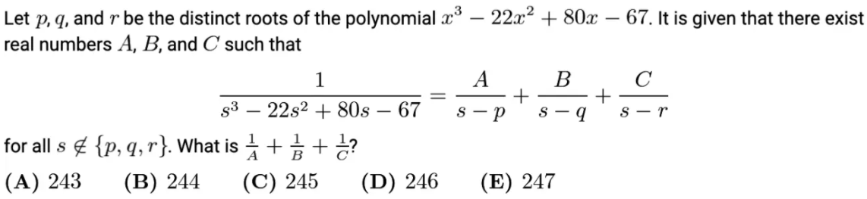
Example

Slide 26
Chapter 7
Arithmetic Mean-Geometric Mean Inequality

Slide 27
Lead in

Slide 28
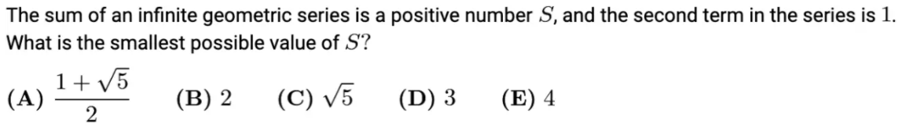
Example

Slide 29
Chapter 8
Binomial Theorem

Slide 30
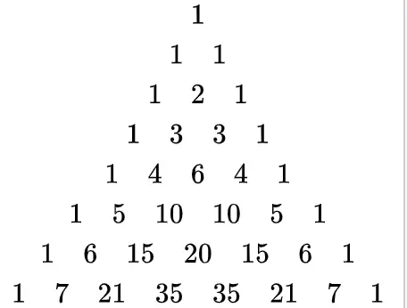
Lead in
Pascal triangle

Slide 31
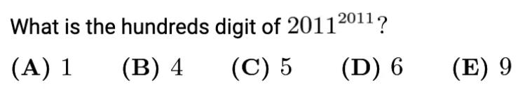
Example

Slide 32
Chapter 9
Partition Ratio Theorem

Slide 33
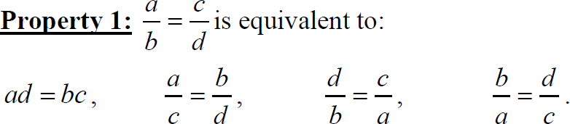
Lead in

Slide 34


Lead in

Slide 35
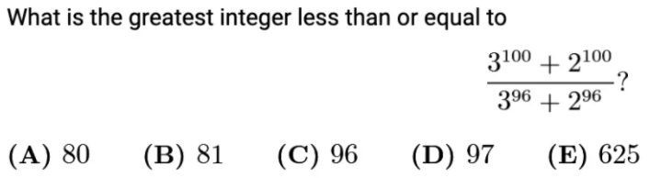
Example

Slide 36
Chapter 10
Polynomial Remainder Theorem

Slide 37
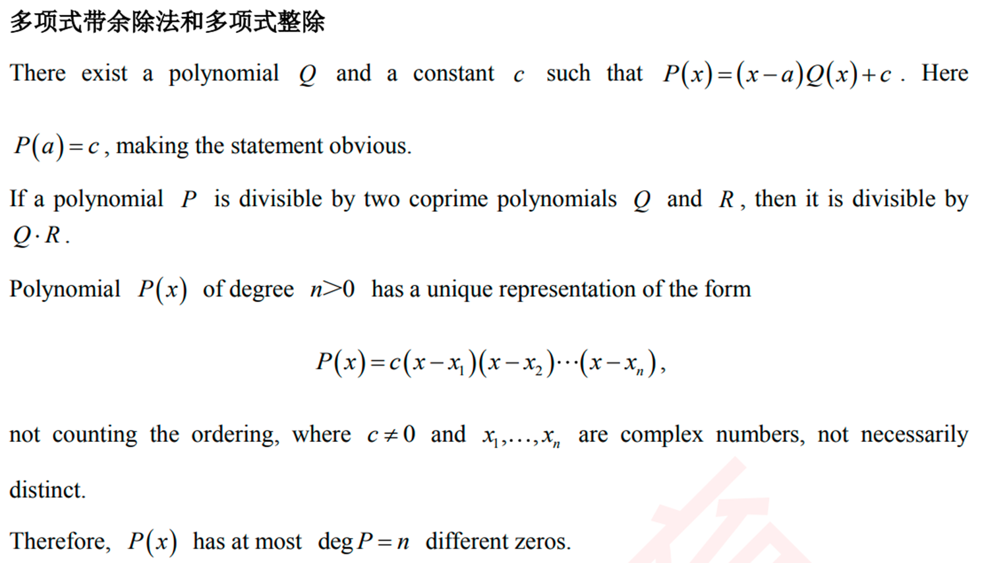
Lead in

Slide 38
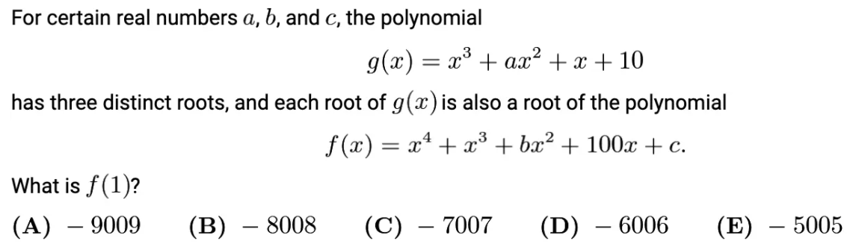
Example

Slide 39
See You Next Time!

